Slide 1
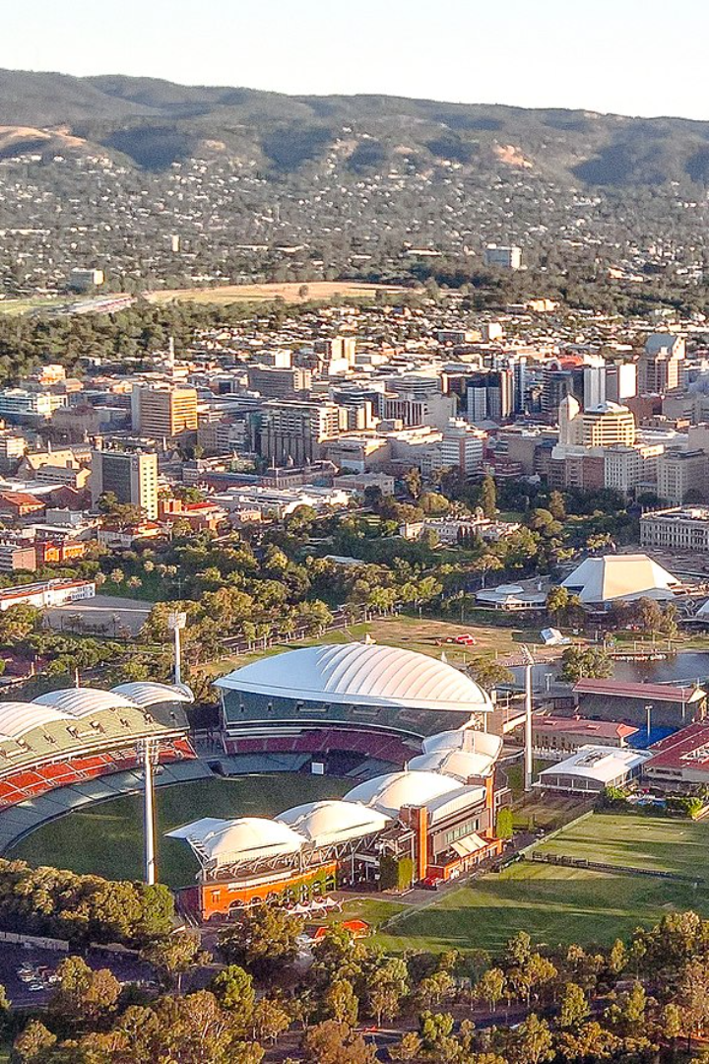
Public Transportation Efficiency Analysis of Australian Buses in Adelaide City
Welcome to the presentation on the Public Transportation Efficiency Analysis of Australian buses in Adelaide City. In this analysis, we will explore the data in IBM Cognos for visualization, as well as the use of Data Exploration and Data Visualization techniques using Python in Jupyter Notebook. Join us as we uncover valuable insights and make informed decisions to improve the efficiency of public transportation.

Slide 2
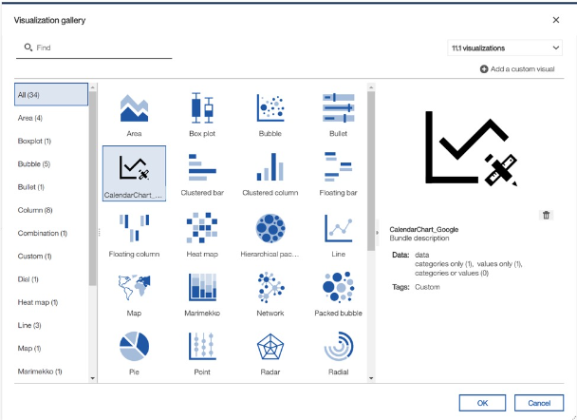
Data Visualization in IBM Cognos
One of the key components of our analysis involves creating a visually appealing and informative dashboard in IBM Cognos. The dashboard will provide a comprehensive view of the data, enabling stakeholders to easily understand and interpret the insights. By leveraging the power of IBM Cognos, we can unlock the full potential of our data and drive data-driven decision-making.

Slide 3
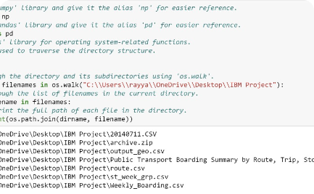
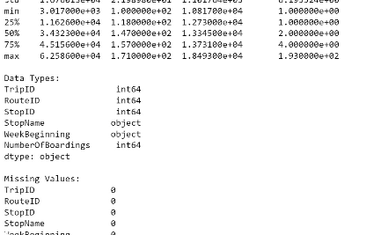
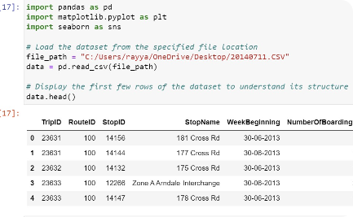
Data Exploration with Python
Data Loading
Data Cleaning
Data Processing
Data loading is a crucial step in the machine learning pipeline, and it involves bringing your dataset into a format that can be easily manipulated and used for training or analysis. Here are some key points about data loading:
Data cleaning, also known as data cleansing or data scrubbing, is a crucial step in the data preparation process. It involves identifying and correcting errors or inconsistencies in datasets to improve their quality.
.Data processing is a crucial step in turning raw data into meaningful information. It involves the collection, manipulation, and transformation of data to extract valuable insights.

Slide 4
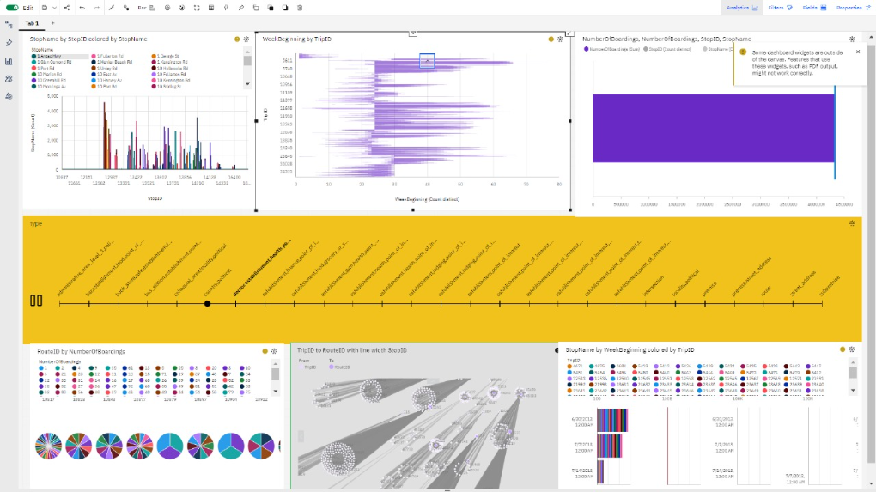
Creating Dashboard in IBM Cognos
Creating a dashboard in IBM Cognos involves designing interactive visualizations and reports that provide a comprehensive overview of key metrics. Utilizing Cognos Studio, users can drag and drop elements to construct dashboards, incorporating dynamic filters and prompts for user interaction. The final dashboard can be published for widespread accessibility, fostering informed decision-making through a user-friendly interface.

Slide 5
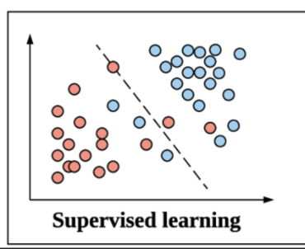
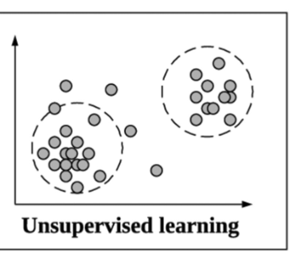
Mastering Machine Learning Models
Supervised Learning
Unsupervised Learning
Supervised learning is a type of machine learning where the model is trained on a labelled dataset, meaning that the input data is paired with the corresponding correct output. The goal is for the model to learn the mapping between the inputs .
Unsupervised learning is a type of machine learning where the algorithm is given unlabelled data and must find patterns and relationships within the data on its own. The goal is often to explore the hidden structure in the data or group similar data points.

Slide 6
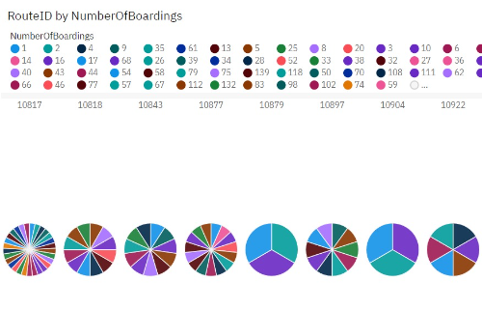
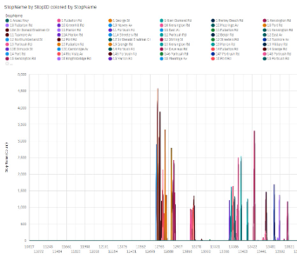
Visualization Insights
The dataset includes a RouteID column, which appears to represent the specific bus route, and a NumberOfBoardings column, indicating the number of passengers boarding the bus at each stop. RouteID serves as a categorical identifier, while NumberOfBoardings provides a numerical measure of passenger activity at various stops along the routes.
In the dataset, "StopName" refers to the name or description of bus stops, while "StopID" provides a unique identifier for each stop. These stop names and IDs are essential for tracking and analyzing bus trips, enabling route planning, and facilitating passenger boarding data collection and management.

Slide 7
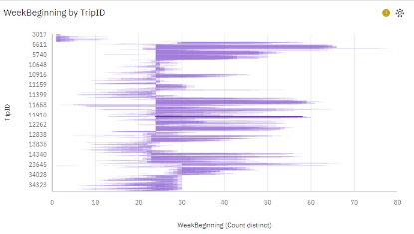
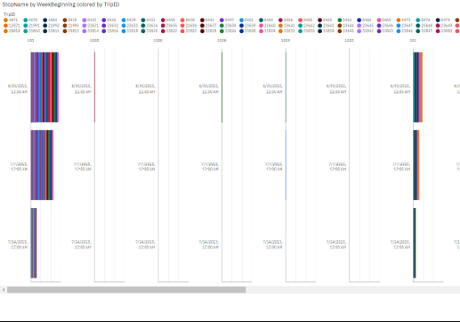
Visualization Insights
In the provided dataset, "WeekBeginning" represents the start date of a week, and "TripID" is a unique identifier for bus trips. The data records passengers' boardings during these trips, allowing analysis of boarding patterns over time.
In the provided dataset, the "StopName" and "WeekBeginning" columns contain information about bus stops and the start date of data collection. For example, one entry shows "StopName: 181 Cross Rd" and "WeekBeginning: 30-06-2013." These details enable analysis of passenger boardings at specific stops during a given week, facilitating insights into transit usage patterns and trends.

Slide 8
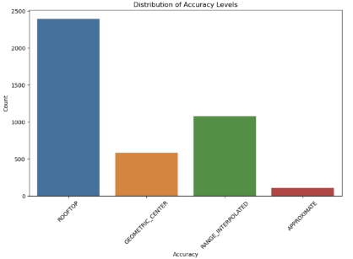
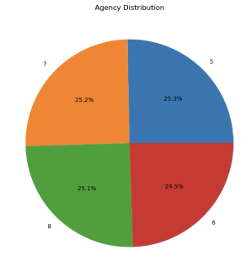
Jupyter Visualization
Bar Graph
Pie Chart
Objectives: The code creates a count plot to visualize the distribution of different accuracy levels in the 'df' DataFrame. It aims to show the frequency of each accuracy value within the dataset.
Objectives: The code creates a pie chart to visualize the distribution of agencies based on their counts in the 'data' DataFrame. It aims to represent the proportion of each agency in the dataset.
Insights: This plot provides a visual representation of the distribution of accuracy levels, allowing you to understand how many data points belong to each specific accuracy category.
Insights: This chart provides insights into the relative size of each agency in the dataset, displaying the percentage contribution of each agency to the whole.

Slide 9
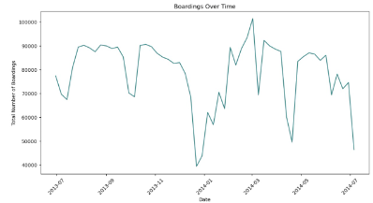
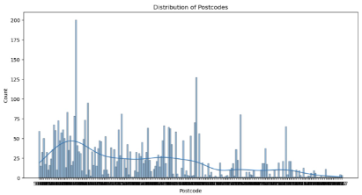
Jupyter Visualization
Stock Chart
Trellis line Graph
Objectives: The code first converts the 'WeekBeginning' column to a datetime object. Then, it groups the data by date and calculates the total boardings per day. Finally, it creates a line plot to visualize the trend of daily boardings over time.
Objectives: The code creates a histogram plot to visualize the distribution of postcodes in the 'df' DataFrame. It aims to show the frequency of postcodes with 20 bins and includes a kernel density estimate (KDE) for a smoother representation.
Insights: This code helps to understand how the total number of boardings changes over time, revealing trends or patterns in the data..
Insights: This plot provides insights into the distribution of postcodes, helping to understand the concentration of data points in different postcode categories. The KDE overlay shows the estimated density of the data.

Slide 10
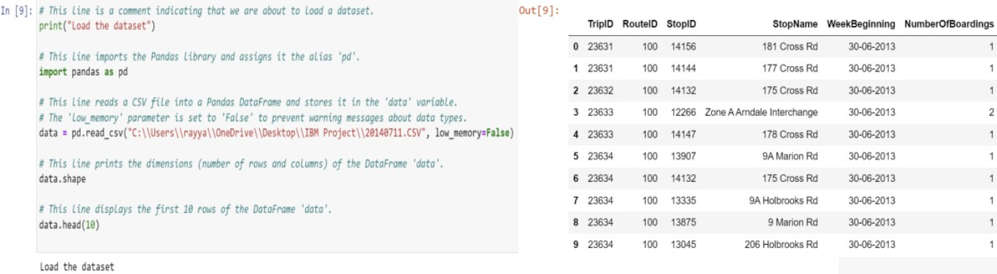
Data Loading
Data loading is the pivotal process of transferring raw data into a system for analysis. This involves extracting data from various sources, transforming it, and loading it into a designated repository for processing.

Slide 11
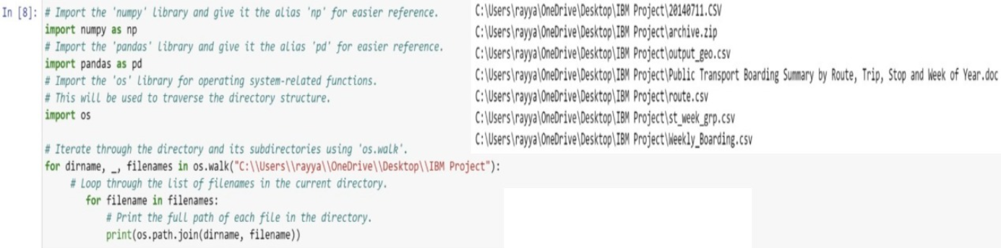
Data Pre-Processing
Data preprocessing is a critical step in refining raw data for analysis. It includes cleaning, normalization, and transformation, ensuring a high-quality dataset for accurate insights and model training in machine learning.

Slide 12
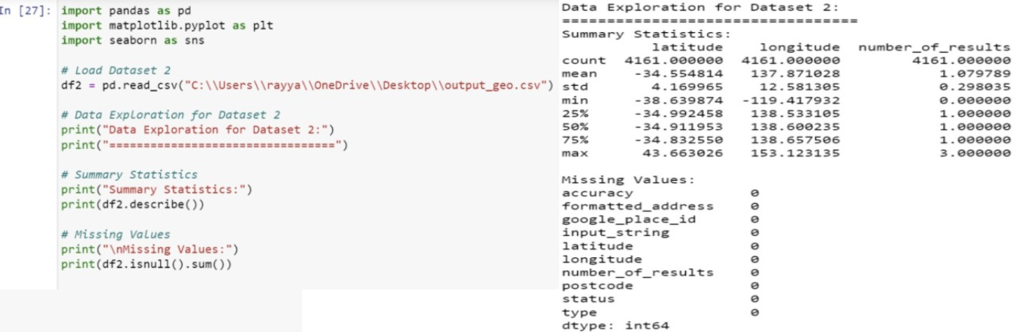
Data Cleaning
Data pre-cleansing is a critical step in preparing datasets for analysis. It involves identifying and rectifying issues like missing values, duplicates, and outliers, ensuring data accuracy and reliability.

Slide 13
Conclusion
In conclusion, our analysis of the Australian buses in Adelaide City has provided valuable insights into improving the efficiency of public transportation. By leveraging IBM Cognos for data visualization and Python for data exploration and machine learning, we have uncovered hidden patterns, identified areas for improvement, and made data-driven recommendations.

Slide 14
Future Report: Phase 5
Looking ahead, in Phase 5, we will conclude our analysis and show the overall summary into the dataset. The future report will focus on advanced predictive modelling and optimization techniques to further enhance the efficiency and effectiveness of the public transportation system. Stay tuned for more exciting developments!

